Slide 1
Projects
Planning, Execution, Tracking, and Evaluation
IEEE
Dave Foye

Slide 2


Slide 3


Slide 4
What is Project Management?
Identifying; clarifying goals (Concept and Scope)
Planning and organizing tasks (Plan)
Working a structured framework to help a group work productively (Process)
Use of communication tools to help maintain focus and teamwork
Tracking progress and results

Slide 5
Why Project Management?
Need is related to complexity
Multiple people
Multiple resources (labs, equipment, etc.)
Multiple tasks – some must precede others
Multiple decision points – approvals
Limited funds
Matching of people/resources to tasks
PLAN ACCORDING TO COMPLEXITY

Slide 6
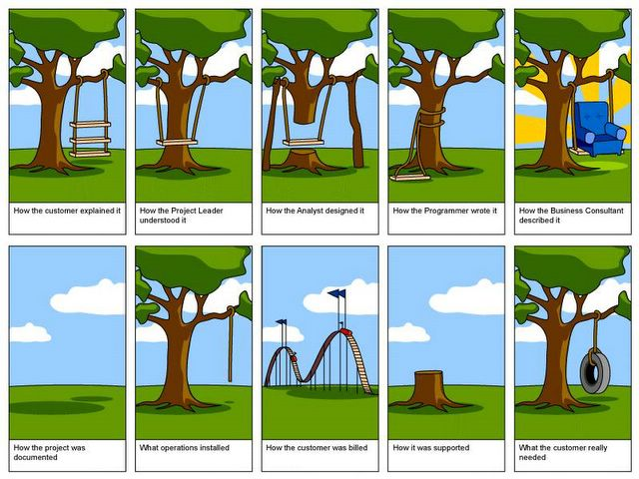

Slide 7


Slide 8
The Critical Path
Sometimes task B cannot be started before task A is completed
Other types of constraints – calendar, lags, etc.
What is Critical path – any slippage slips whole project
Helpful to know what tasks are on the critical path
Useful to try to shorten the critical path
Example: Ordering Materials

Slide 9
Suggested Steps in Project Management
Create a careful definition of the project, with goals, constraints, assumptions
Identify project start/end dates, any mandatory milestones, including reports, signoffs, deliverables, etc.
Determine what processes are required
List constraints – money, equipment availability, holidays, etc.
Identify tasks to be accomplished – high level

Slide 10
Project Management : The Goals
Identify the concept (what)
Identify all processes (how)
Identify endpoints (when)
Identify measures of success, for whom

Slide 11
Project Processes
Work Processes- Planning, Concept, Design, Build, Document
Communication processes- meetings, notes, e-mail, phone
Reporting and evaluation processes- who and how
Problem solving processes
Resource management

Slide 12
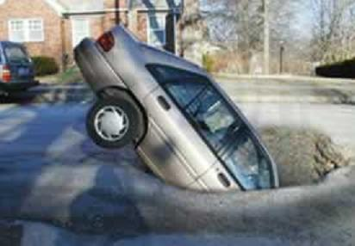
What happened?

Slide 13
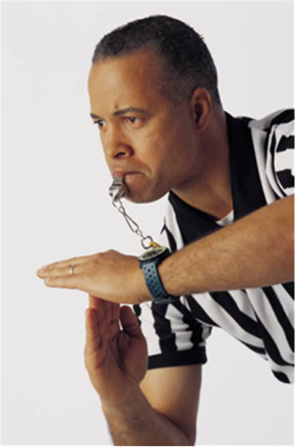
Problem
Detection
And Team
Reaction

Slide 14
Suggested Steps, cont.
Refine detailed task list, dropping/ combining, adding things omitted
Then, for each task in list:
Estimate time
Identify dependencies among tasks- first, last, sequences
Identify resources needed(people, money, parts, etc.); constraints

Slide 15
Suggested Steps, cont.
Organize task groups roughly by starting date
List dependencies that should or MUST hold
Make a GANTT chart to help see timing and task relationships
Identify the critical path
Identify “task leads”; who will do what

Slide 16
Suggested Steps, cont.
As project progresses:
Monitor, record progress on all tasks, at least weekly – use “Tracking Gantt Chart”
Pay particular attention to those on critical path
Revise plan as needed to take into account changes, adapt to meet milestones

Slide 17
The Gantt Chart
List of Tasks on a time line
Estimates of how long each task will take
Important points Marked
Especially Good for groups, and tasks longer than a week
Helps think through planning

Slide 18
Example Gantt Structure
Design
Build
Test
Calibrate
April
May

Slide 19
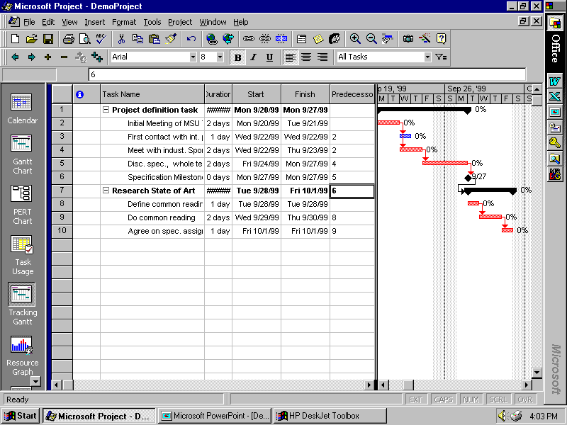

Slide 20
Making a Project a Success
Allow for learning
Evaluate feasibility
Problems- evaluate and re-plan
Facilitate Problem solving processes
Watch Resource management
Keep team together-communicate
Beware of scope creep…

Slide 21






Slide 22
Management of YOUR Project
With your team members
Create a plan for the entire project
Set milestones for tracking progress
Provide more detail for near-term tasks
Use with your facilitator to report progress and revise/add detail to plan
Assign specific tasks to team members
Revise plan and activities as required to achieve objectives

Slide 23
Simple Summary Steps
Outline Goal and Concept
Evaluate Feasibility
Set specific goals with team
Detail Plan, Work with Team on Tasks
Start work when everyone understands plan
Evaluate progress, re-plan when needed
Problems? Adapt and re-plan
Succeed with your well planned project!

